Slide 1
Lecture 17:
Enantiomers
R,S-system to name enantiomers
R/S indicates the absolute stereochemistry
at a chiral center (stereocenter)

Slide 2
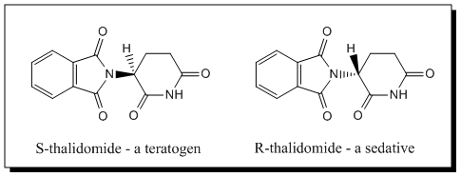
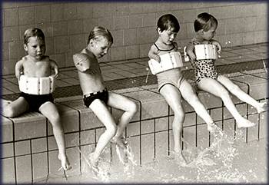
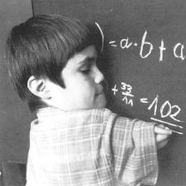

Slide 3
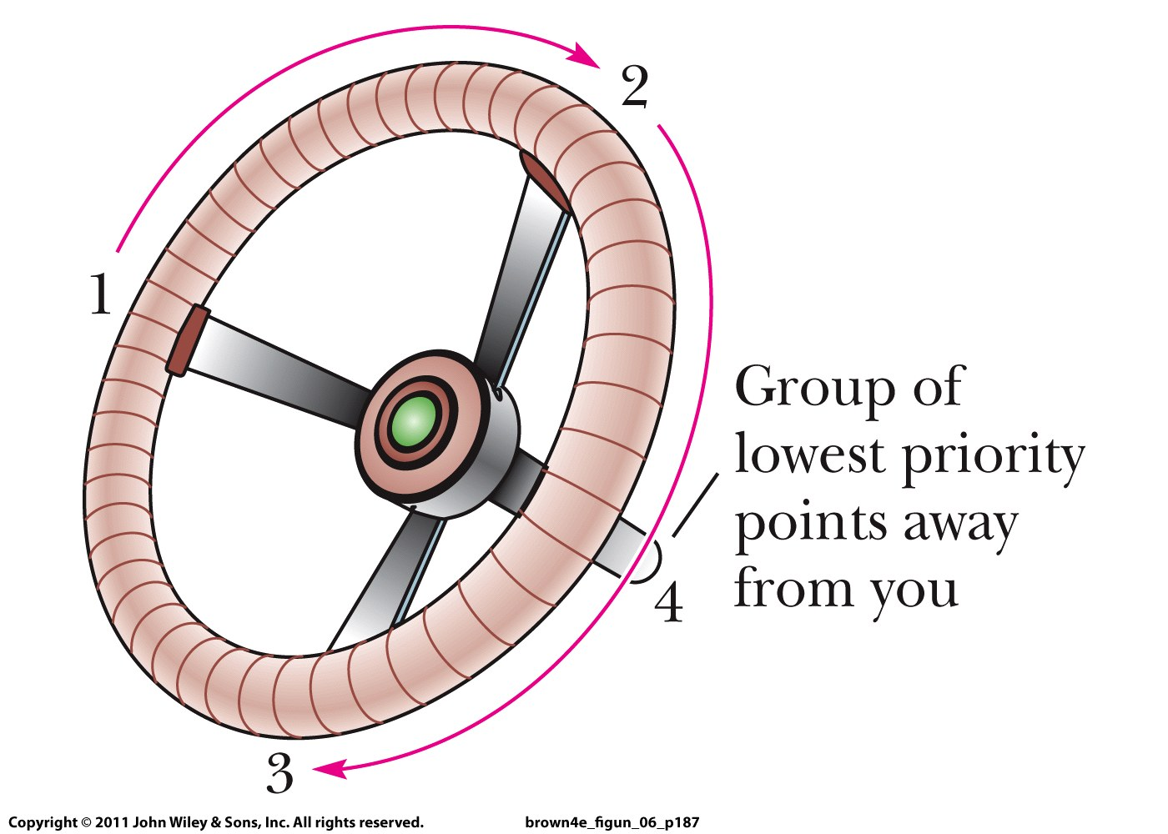

Slide 4
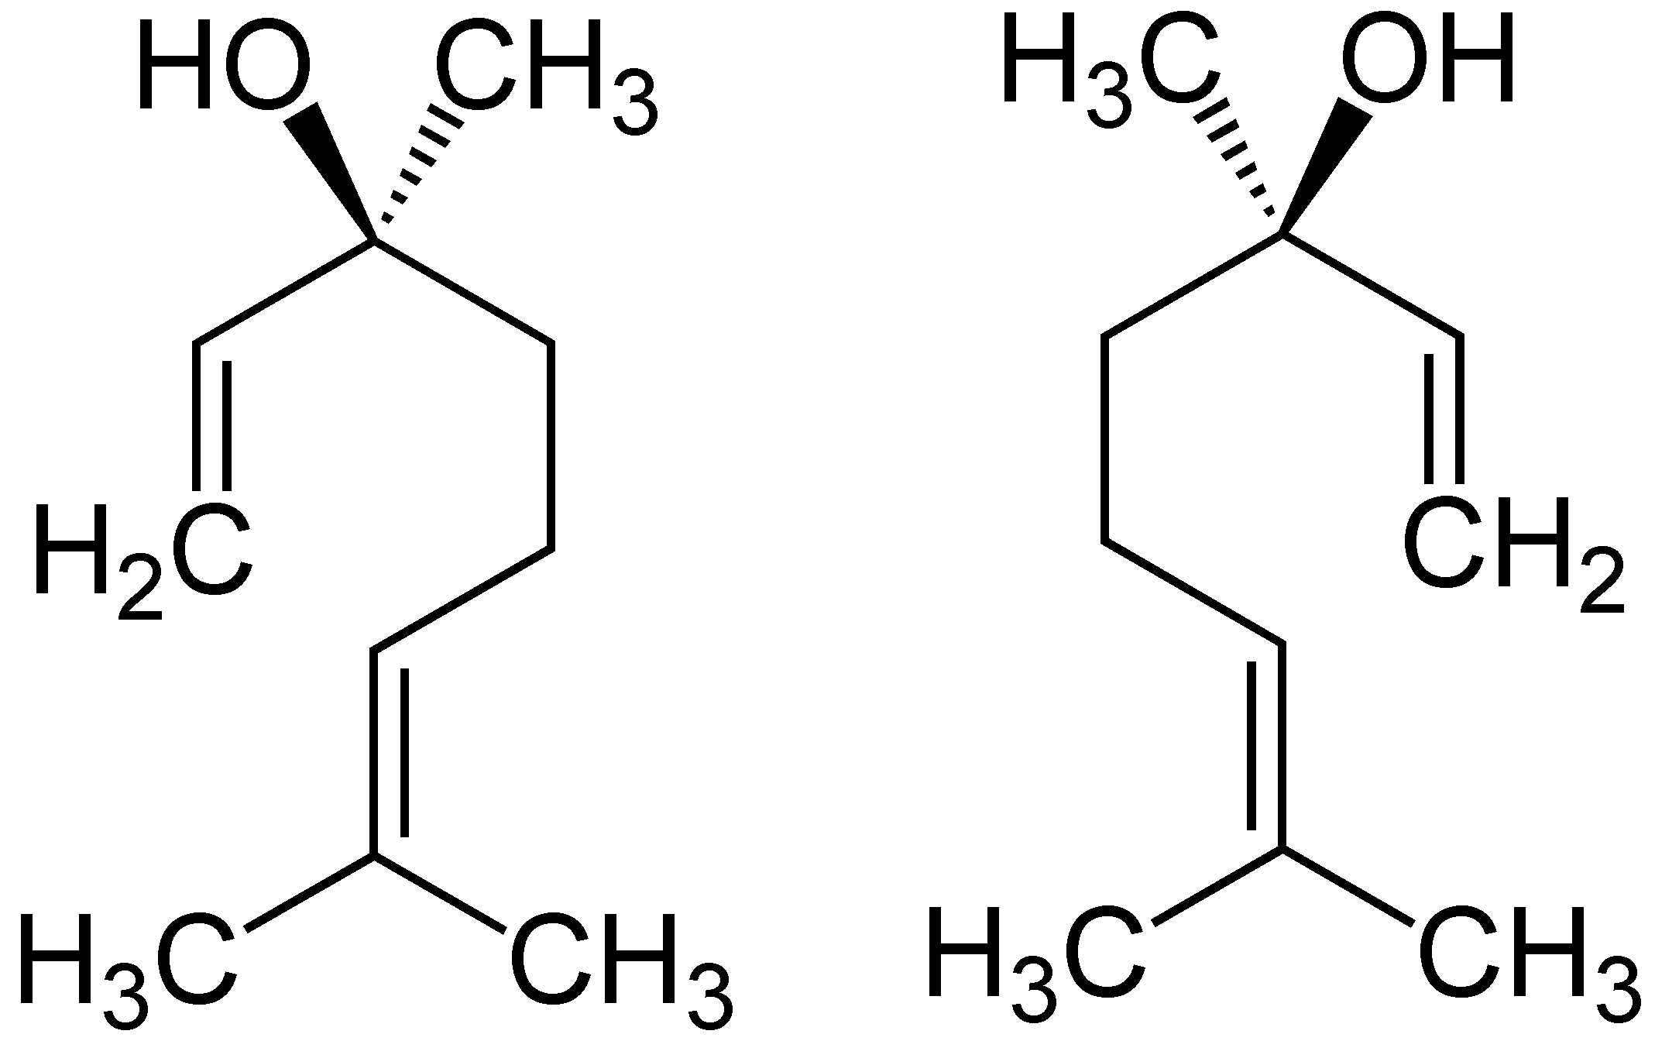

Slide 5
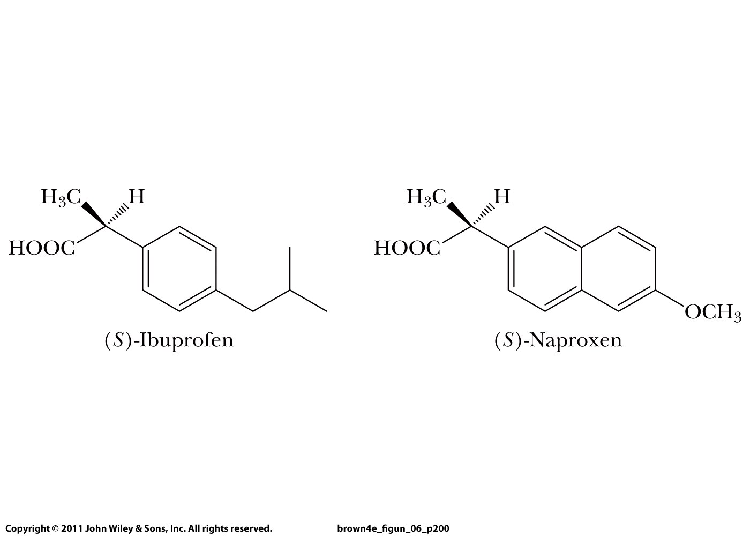

Slide 6
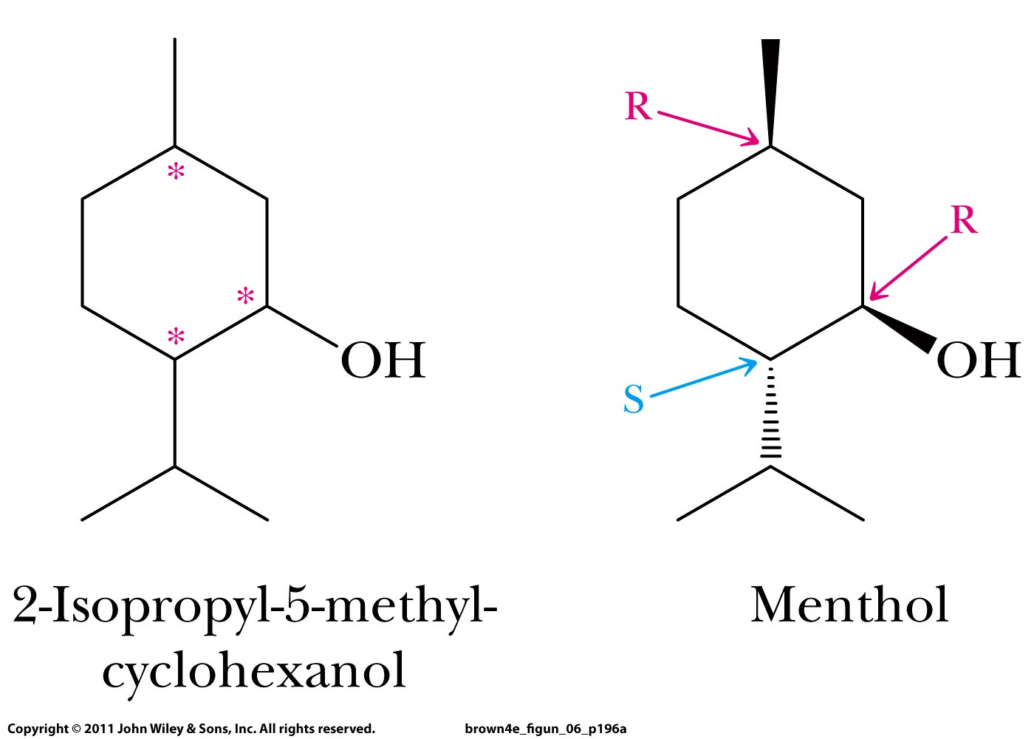
5
5
4
3
1
2
1
2

Slide 7
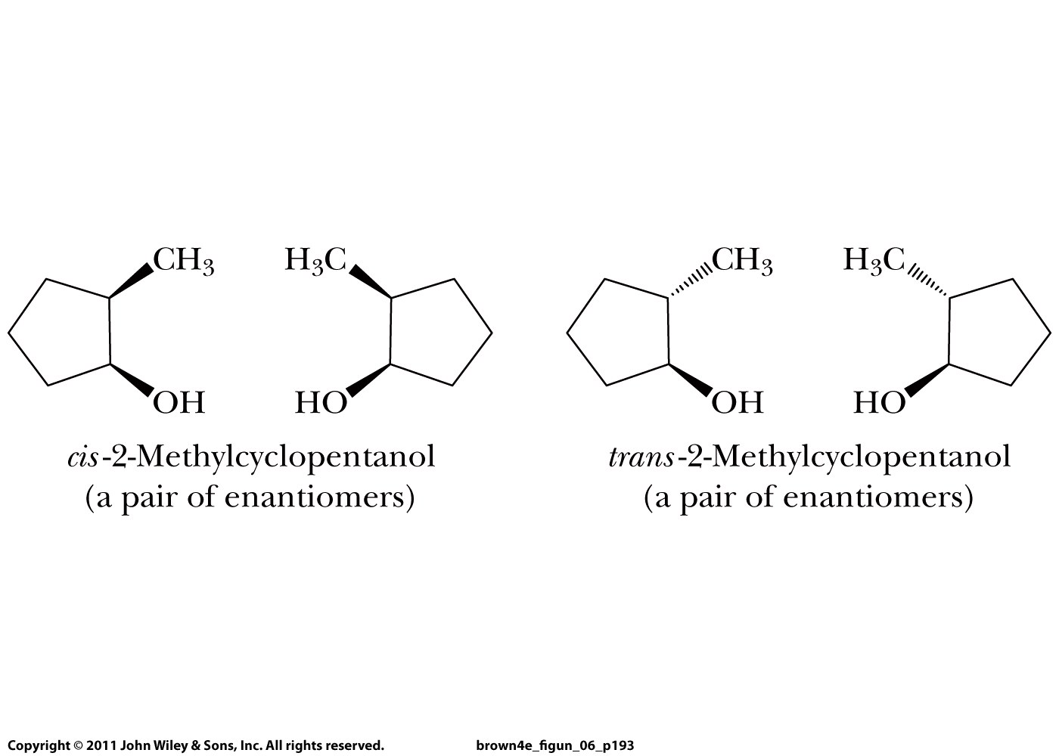
n = 2 stereocenters => 2^{n} = 4 stereoisomers
diastereomers

Slide 8
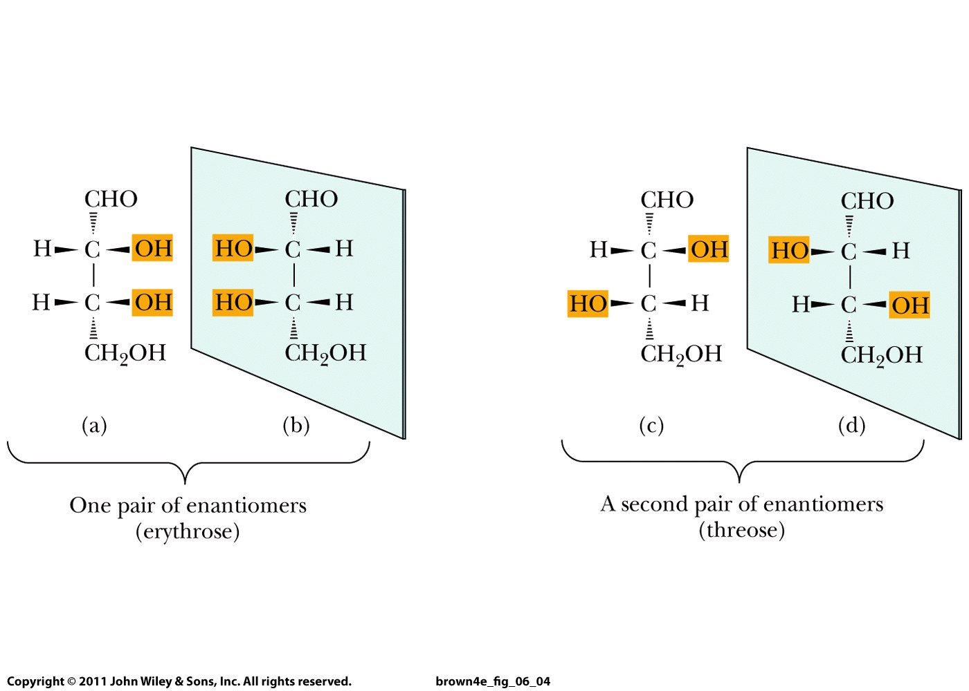
n = 2 stereocenters => 2^{n} = 4 stereoisomers
diastereomers

Slide 9
n = 2 stereocenters => 2^{n} = 4 stereoisomers
Enantiomers have opposite absolute configurations in their
chiral centers
R
S
R
S
R
S
S
R
Diastereomers do not

Slide 10
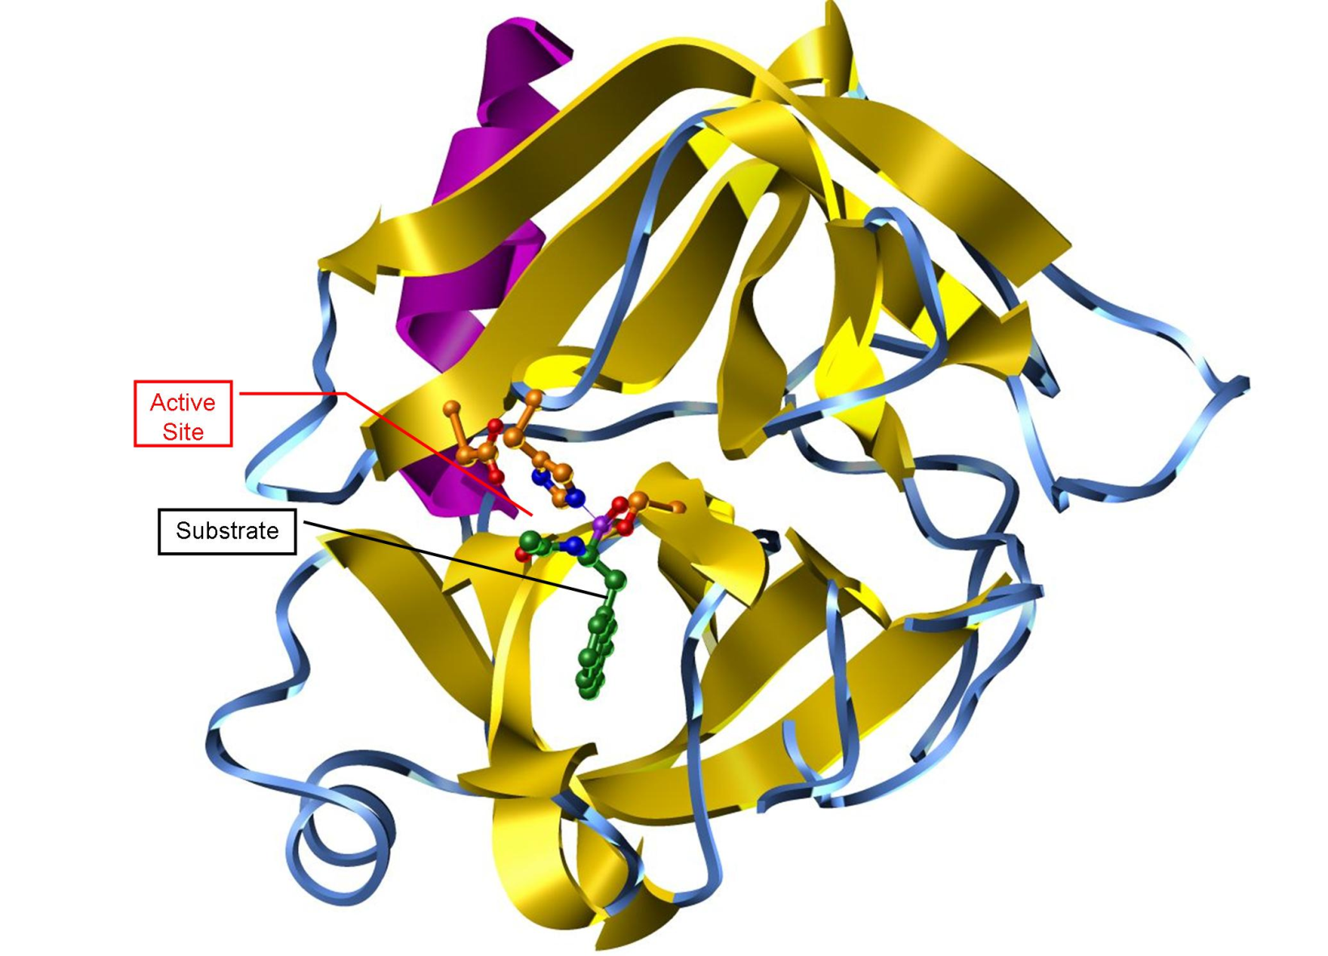
Chymotrypsin: animal enzyme in intestines
that catalyzes digestion of proteins
251 stereocenters
2²⁵¹ possible
stereoisomers
Only ONE is
produced by any
given organism

Slide 11
